Slide 1
PRINTED CIRCUIT BOARD ANALYSIS
MOHAMMED AZHARUDEEN 1510110486
SRINIVASAN NANDAKUMAR 1510110403

Slide 2
WHAT IS PCB?
A printed circuit board (PCB) mechanically supports and electrically connects electronic components or electrical components using conductive tracks, pads and other features etched from one or more sheet layers of copper laminated onto and/or between sheet layers of a non-conductive substrate. Components are generally soldered onto the PCB to both electrically connect and mechanically fasten them to it.
A basic PCB consists of a flat sheet of insulating material and a layer of copper foil, laminated to the substrate. Chemical etching divides the copper into separate conducting lines called tracks or circuit traces, pads for connections, vias to pass connections between layers of copper, and features such as solid conductive areas for EM shielding or other purposes.

Slide 3
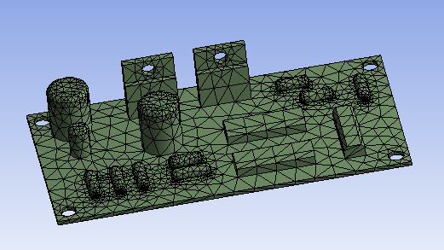
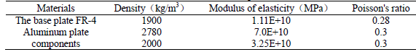
3D MODEL USED IN OUR ANALYSIS

Slide 4
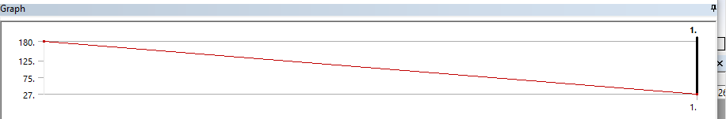
STATIC STRUCTURAL ANALYSIS
A static structural analysis determines the displacements, stresses, strains, and forces in structures or components caused by loads that do not induce significant inertia and damping effects.
.
THERMAL CONDITION USED:

Slide 5
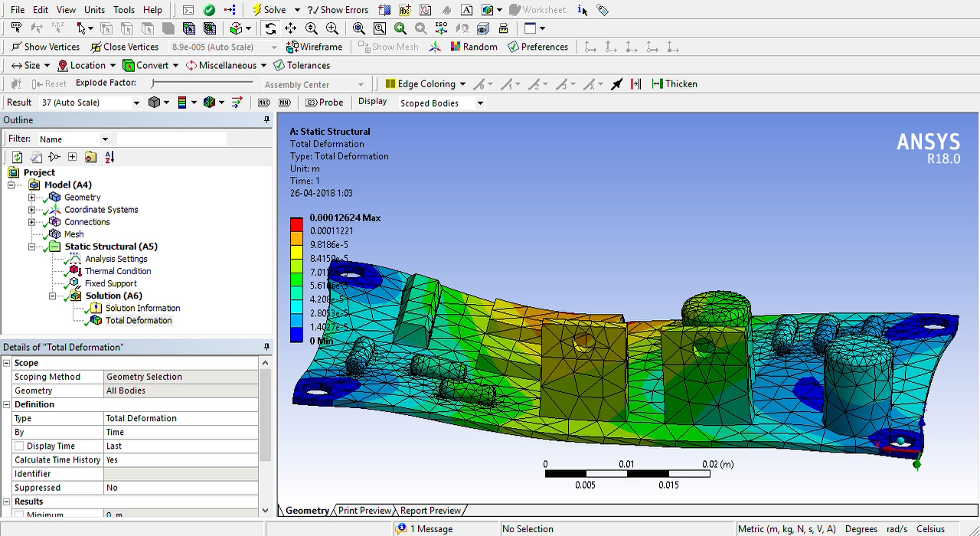
STATIC STRUCTURAL ANALYSIS

Slide 6
MODAL ANALYSIS
The printed circuit board (PCB) plays a vital role in modern electrical equipment and its reliability will affect electrics greatly. In order to study the vibration characteristics of the PCB, to guarantee its reliability, the finite element model of the PCB is established in ANSYS for the theory of modal analysis.
Printed circuit board (PCB) as the key part in electronic devices, if by dynamic load is bigger, or although is not big, but the frequency of the force and the structure of a certain natural frequency approaches, will produce strong resonance circuit module, which lead to high dynamic stress, strength of structure damage or not allowed deformation.

Slide 7
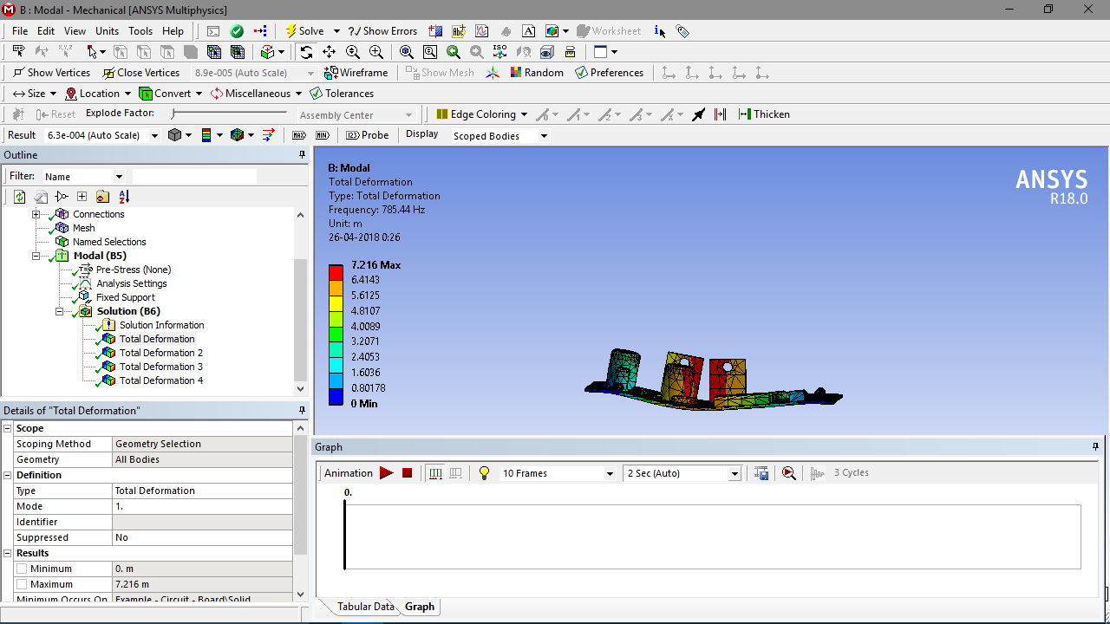

Slide 8
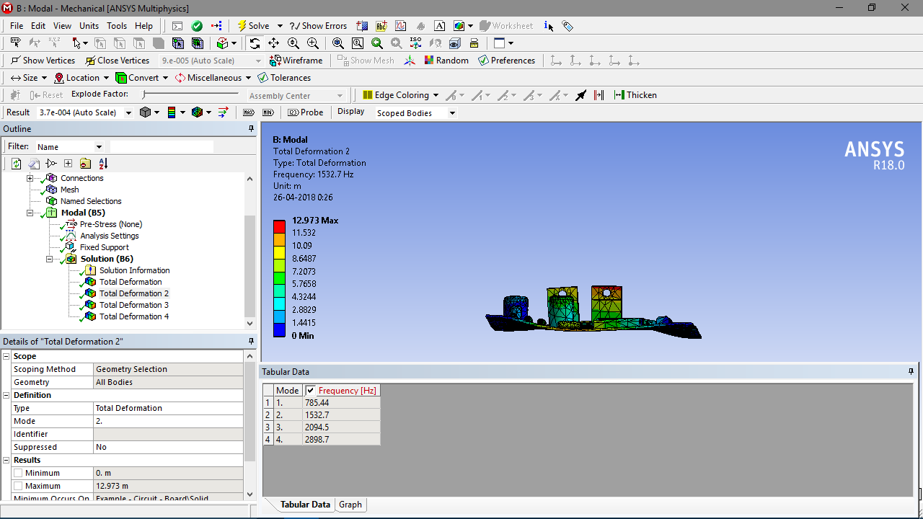

Slide 9
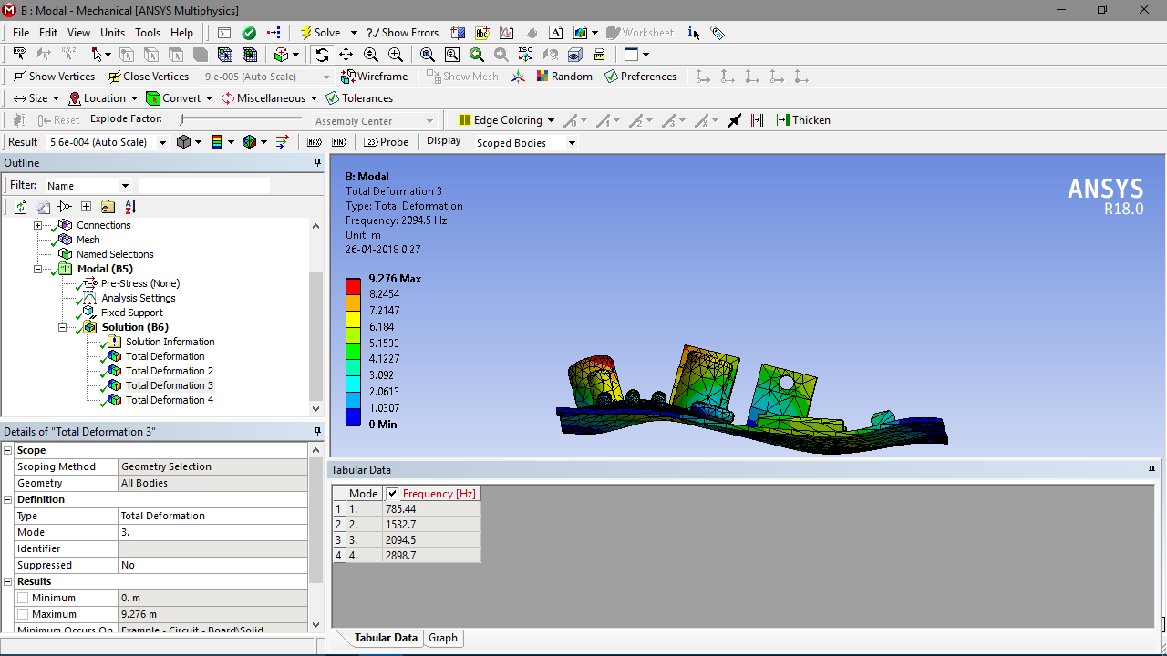

Slide 10
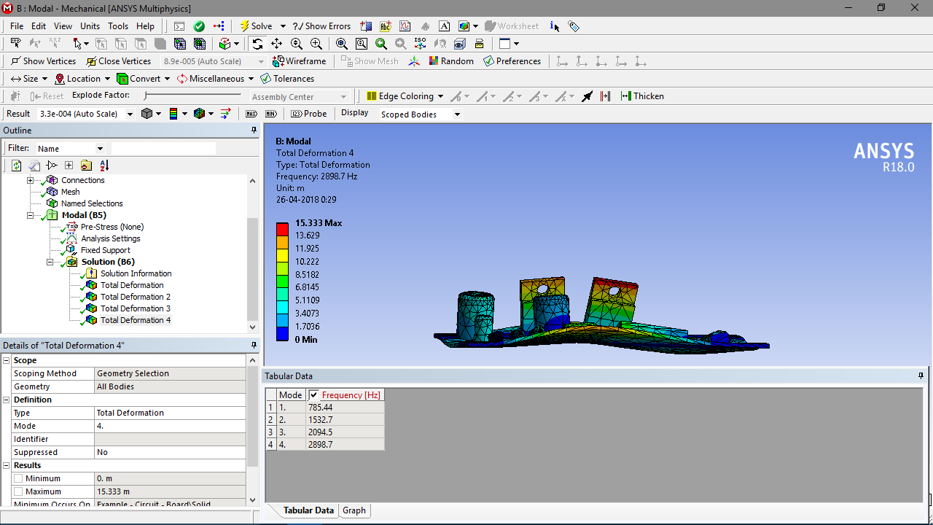

Slide 11
CONCLUSION OF OUR ANALYSIS
A structural system is the combination of structural elements and their materials. It is important for a structural engineer to be able to classify a structure by either its form or its function, by recognizing the various elements composing that structure. The structural elements guiding the systemic forces through the materials are not only such as a connecting rod, a truss, a beam, or a column, but also a cable, an arch, a cavity or channel, and even an angle, a surface structure, or a frame
Under the premise of the equivalent cad model, quantitative analysis of the impact of a PCB thickness to its natural frequency is made in ANSYS. The results show that the natural frequency of the PCB increases with the increase of the thickness, and the higher order leads to the faster growth, which will provide a reference for the PCB designing.

